Slide 1
CSE 12 – Basic Data Structures and Object-Oriented Design Lecture 24
Greg Miranda & Paul Cao, Winter 2021
This lecture is being recorded

Slide 2
Announcements
Quiz 24 due Wednesday @ 8am
Survey 10 due Friday @ 11:59pm
PA8 due Thursday @ 11:59pm
No resubmission
PA7 Resubmission due Friday @ 11:59pm
Final Exam
Starts Saturday, March 13th @ 8:00am
Ends Monday, March 15th @ 11:59pm
3 hour exam – clock starts when you open exam
Must be finished in one sitting

Slide 3
Topics
Iterators
Questions on Lecture 24?

Slide 4
Iterable Interface
Implementing this interface allows an object to be the target of the "for-each loop" statement.
// Defined in java.lang
public interface Iterable <T> {
/** Returns an iterator over elements of type T. */
Iterator<T> iterator();
}

Slide 5
Iterable Interface
// Defined in java.lang
public interface Iterable <T> {
/** Returns an iterator over elements of type T. */
Iterator<T> iterator();
}
This interface is mostly used when we create a container of certain things and we want to be able to iterate through it without worrying about indexes.
There is no sorting involved.
You can use the iterator from other Java containers to get the iterator

Slide 6

import java.util.Arrays;
class Person{
private String name;
public Person(){ name = null;}
public Person( String name ){ this.name = name;}
public String toString(){ return name; }
}
class CSE12 implements Iterable<Person>{
private Person[] data;
public CSE12 (){
data = new Person[3];
data[0] = new Person("Greg");
data[1] = new Person("Paul");
data[2] = new Person("Christine");
}
public Iterator<Person> iterator(){
return Arrays.asList(data).iterator();
}}
public class IterableTest{
public static void main(String[] args){
CSE12 obj = new CSE12();
for (Person p : obj){
System.out.println(p);
}}}
When this code runs, what will be printed out? A. Christine Greg Paul
B. Gerald Paul Christine
C. Some random order

Slide 7
The Iterator Software Design Pattern
A common situation: A client needs to inspect the data elements in a collection, without wanting to know details of how the collection structures its data internally
Solution:
Define an interface that specifies how an iterator will behave
Design the collection to be able to supply an object that implements that iterator interface
A client then can ask the collection for an iterator object, and use that iterator to inspect the collection’s elements, without having to know how the collection is implemented

Slide 8
Iterator<E> Interface
https://docs.oracle.com/javase/10/docs/api/java/util/Iterator.html
The Iterator<E> interface is defined as follows:
public interface Iterator<E> {
default void forEachRemaining(Consumer<? super E> action)
public E next();
public boolean hasNext();
default public void remove();
}
The ListIterator<E> interface extends the Iterator<E> interface and adds a few more methods…

Slide 9
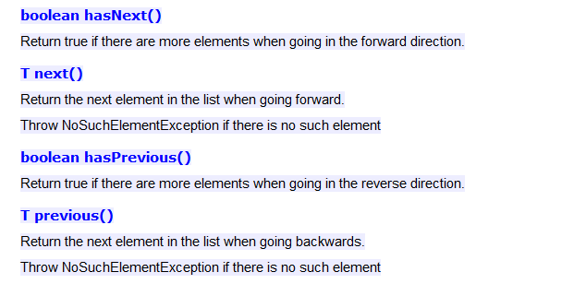
public interface ListIterator<E> extends Iterator<E>
https://docs.oracle.com/javase/10/docs/api/java/util/ListIterator.html

Slide 10
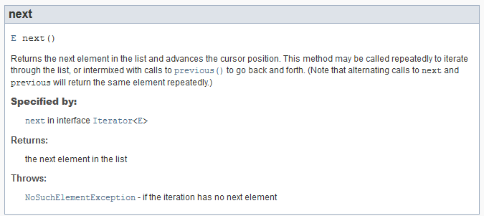

Slide 11
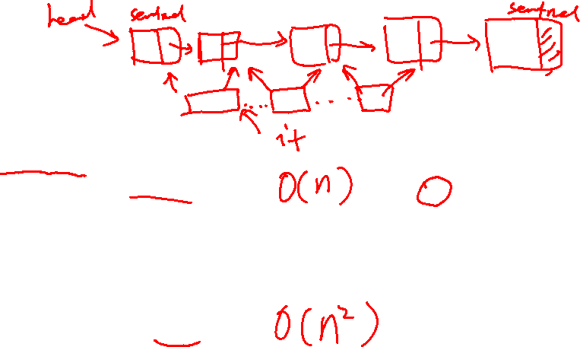
List Traversal
LinkedList<Integer> myL = new LinkedList<Integer>();
// Add the elements 1, 2, 3, 4 to myL (code not shown)
ListIterator<MyObjs> it = myL.listIterator();
while (it.hasNext()) {
System.out.println(it.next());
}
Is there a difference in the behavior between these two blocks of code?
Yes
No
Yes, but not in a way that the user would be able to tell
LinkedList<Integer> myL = new LinkedList<Integer>();
// Add the elements 1, 2, 3, 4 to myL (code not shown)
for (int i = 0; i<myL.size(); i++) {
System.out.println(myL.get(i));
}
Notes:
C

Slide 12
Random Stream
How could we make our random stream so that we can get random numbers in an enhanced for loop?
Random random;
public int nextInt(int bound)
Returns a pseudorandom, uniformly distributed int value between 0 (inclusive) and the specified value (exclusive), drawn from this random number generator's sequence.
public RandomStream(int size, int bound) { }
RandomStream r = new RandomStream(10, 100);
for (Integer i : r) {
System.out.println(i);
}

Slide 13
Other Iterators
How would we make a BST iterator?
What about a Heap iterator?

Slide 14
Questions on Lecture 24?

